Slide 1
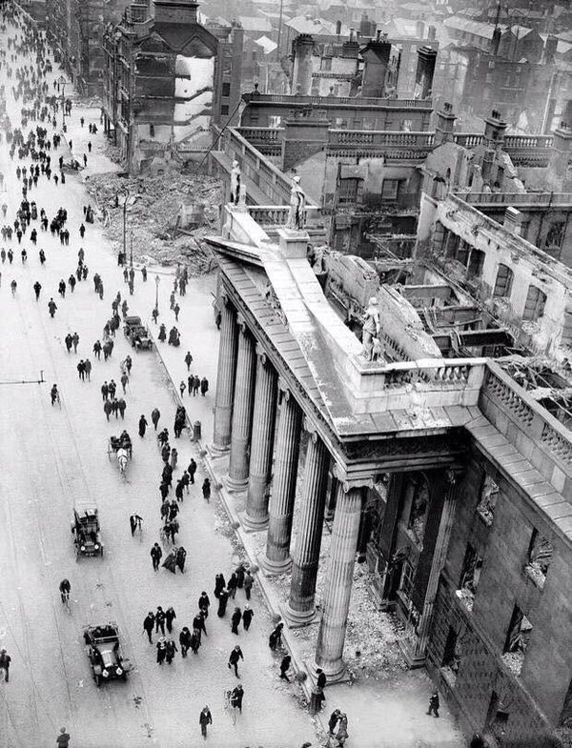
England’s Difficulty, Ireland’s Opportunity
A Chronology of the Events of Easter Week 1916
ffEnglan
Máire Ní Mhórdha
ATHBOY 100

Slide 2
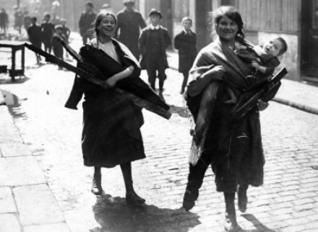
Ireland in 1916
Athboy 100

Slide 3
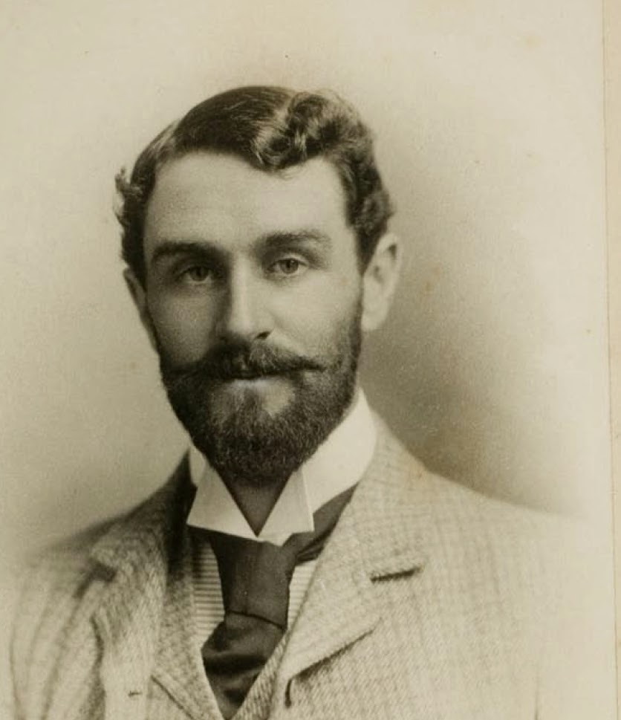
‘The British Empire, and British colonialism, is everywhere a usurpation of the rights of humanity... When Irish nationalists claim our right to self-determination we strike not only at our national subjection but also at the chains that hold Africa and Asia in the same humiliation.’
Roger Casement
Athboy 100

Slide 4
Run-up to the Rising: Key Actors
The Irish Republican Brotherhood (IRB)
The Gaelic Athletic Association (GAA)
The Gaelic League/Conradh na Gaeilge
The Irish Citizen Army
Sinn Féin
The Ulster Volunteers
The Irish Volunteers
Cumann na mBan
Athboy 100

Slide 5
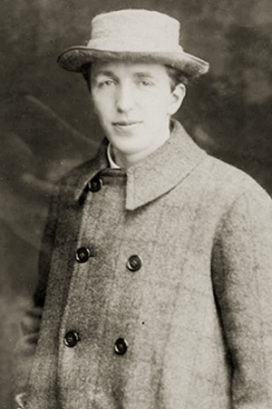
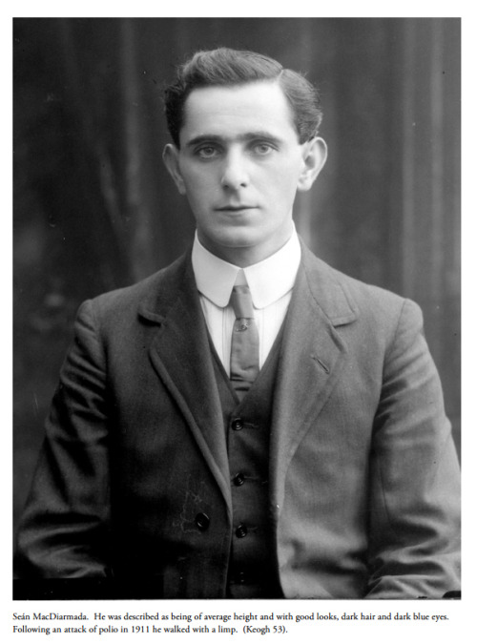

The Irish Republican Brotherhood (The Fenians)
Green and gold
flag of the IRB
Bulmer Hobson
Seán MacDiarmada
Athboy 100

Slide 6
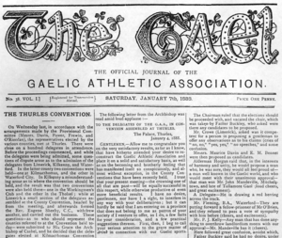
The Gaelic Athletic Association (GAA)
Extract from The Gael, official journal of the Gaelic Athletic Association, 7 January 1888
Athboy 100

Slide 7
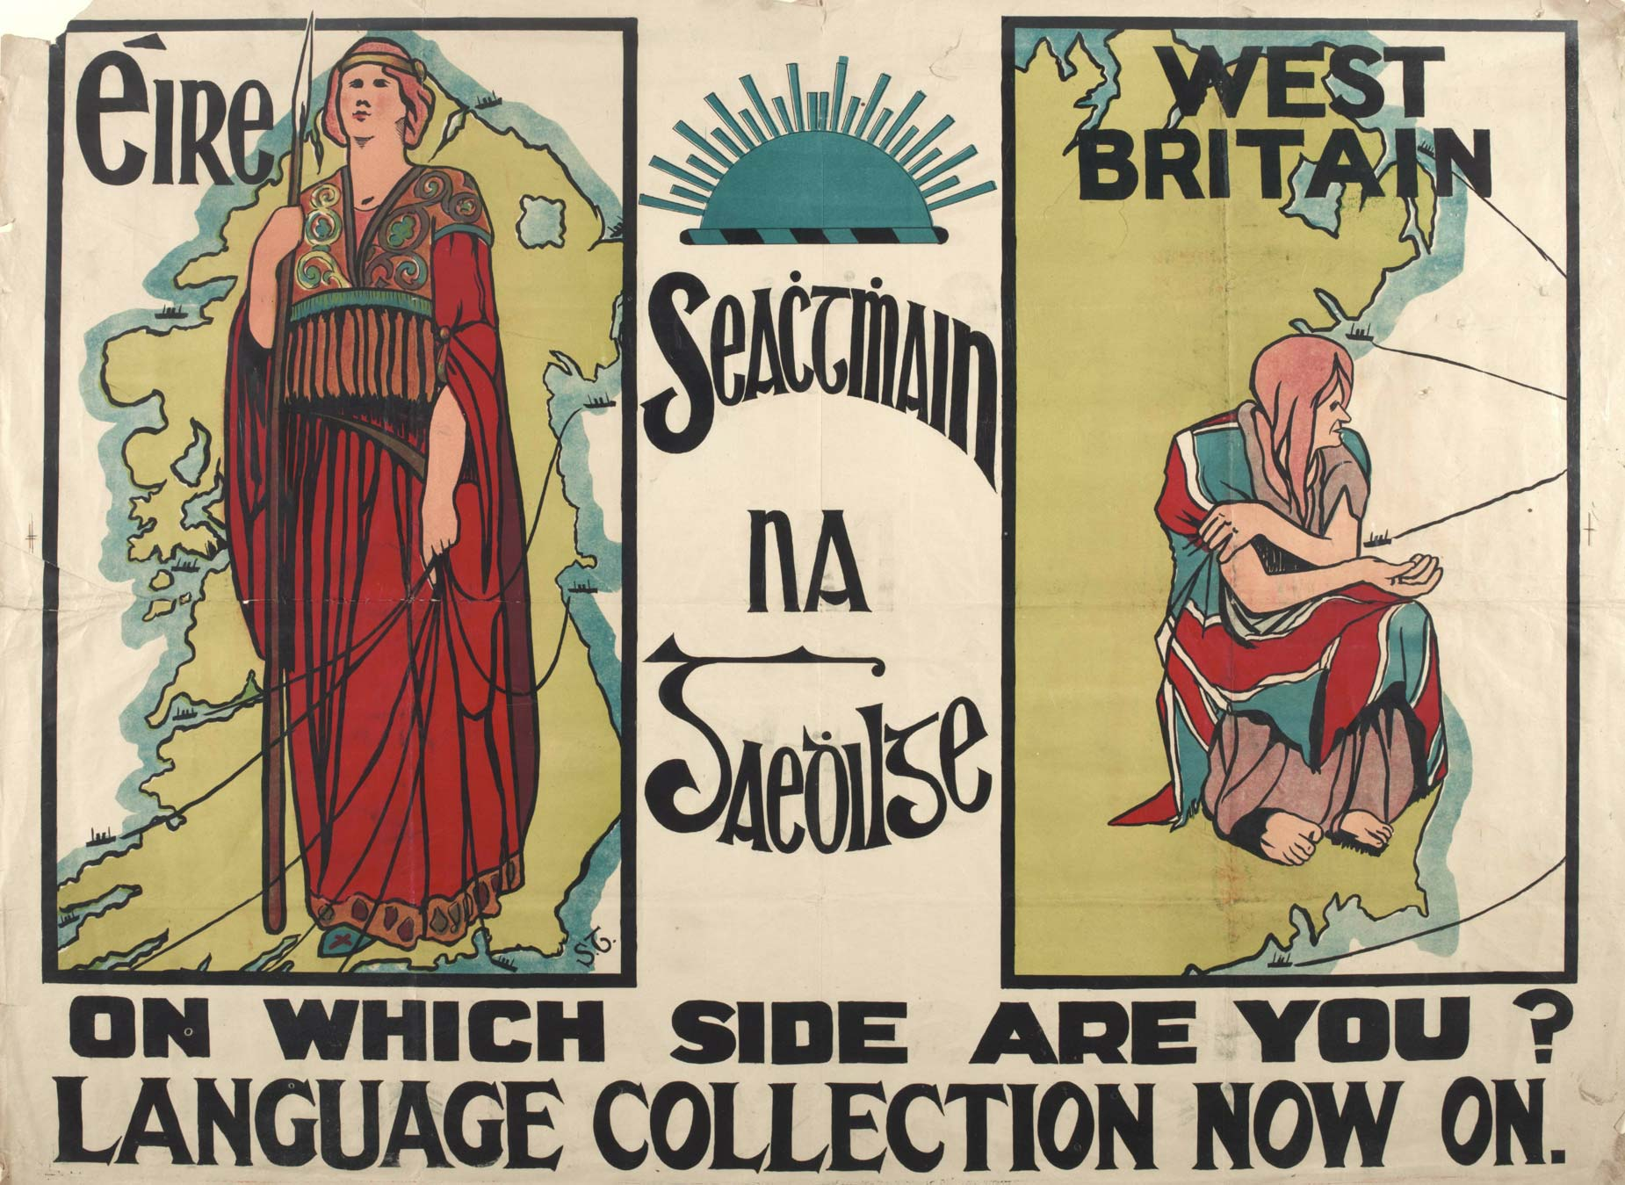
The Gaelic League
Poster for a language collection drive during Seachtain na Gaeilge, 1913
(National Library of Ireland)
Athboy 100

Slide 8
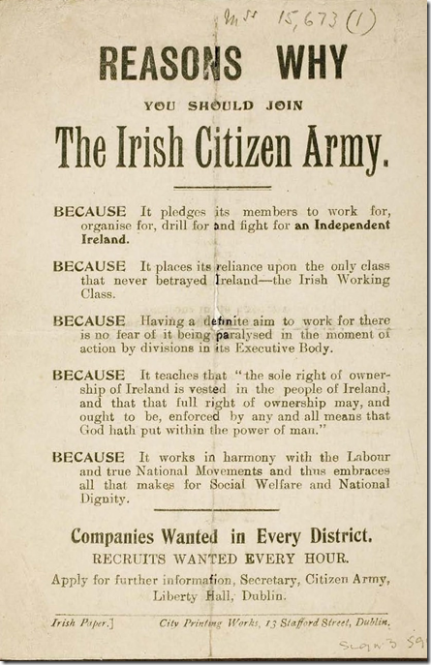
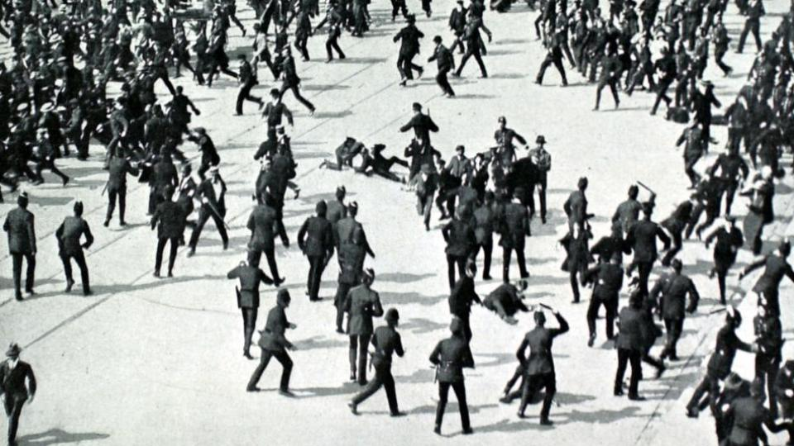
1913 Lockout and the Irish Citizen Army
ICA recruitment poster
Police beat striking workers during the 1913 lockout
Athboy 100

Slide 9
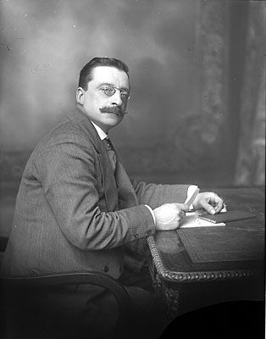
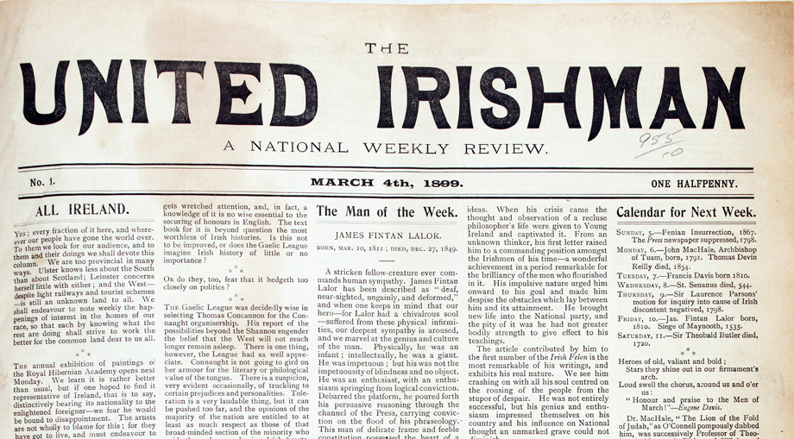
Cumann na nGaedhal (Sinn Féin)
Arthur Griffith, founder (1905) and president (1911-1917) of Sinn Féin
Athboy 100

Slide 10
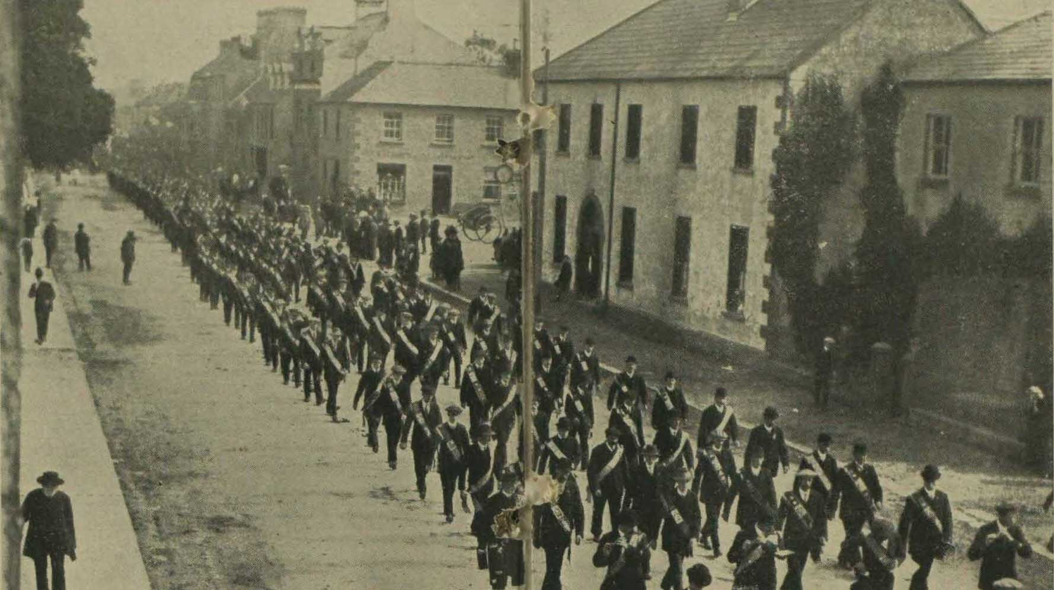
The Ulster Volunteers
Ulster Volunteers drill at Cookstown, 27 September 2013
(London Illustrated News)
Athboy 100

Slide 11
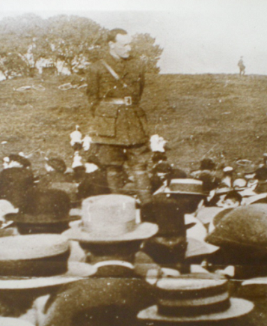
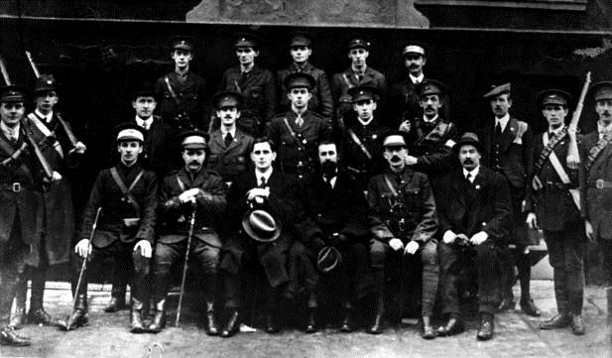
The Irish Volunteers
Irish Volunteers in Cork, 1914
Pádraig Pearse, Director of Operations for the Irish
Volunteers, addressing a public meeting at Dolphins Barn,
in August 1915
Athboy 100

Slide 12
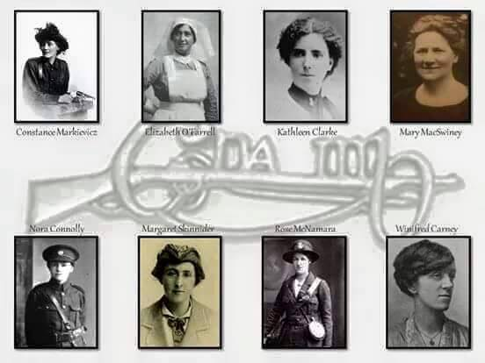
Cumann na mBan
Athboy 100

Slide 13
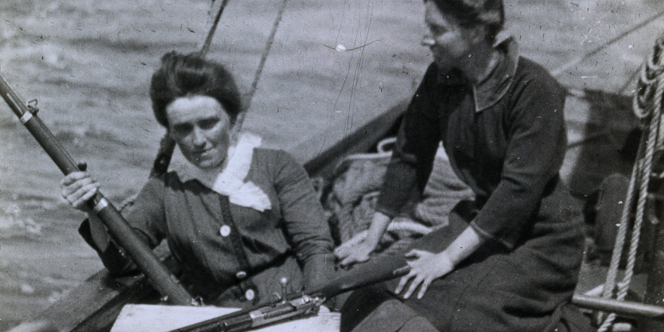
The Howth Gun-Running
Molly Childers and Mary Spring Rice aboard the Asgard during the 1914
Howth gun-running (National Museum of Ireland/Collins Barracks)
Athboy 100

Slide 14
Run-up to the Rising
1914 - First World War declared; Home Rule shelved for duration of the war.
9 September 1914 - IRB decides to stage an uprising while Britain is at war.
29 September 1914 - Redmond urges Volunteers to enlist in the British Army.
May-September 1914 - Military Council of the IRB is formed.
August 1914 - Pearse oration at funeral of O’Donovan Rossa, warning Britain that ‘Ireland unfree will never be at peace.’
January 1916 - Connolly and MacDonagh join IRB Military Council. Rising date confirmed for Easter Sunday.
Athboy 100

Slide 15
Run-up to the Rising (contd.)
April 9th – The Aud departs Germany.
April 12th - Casement boards U-19 submarine in Germany to meet the Aud in Tralee Bay.
April 19th (Ash Wednesday) – forged ‘Castle Document’ presented to Eoin MacNeill, head of the Irish Volunteers, indicating that the British were going to arrest him and all the other nationalist leaders.
April 20th (Holy Thursday) - the Aud arrives (early) at Tralee Bay.
April 21st (Good Friday) - Casement, Bailey and Monteith go ashore from the submarine U-19, and are arrested by the British; later the Aud is captured by the British navy and forced to sail to Cork Harbour.
Athboy 100

Slide 16
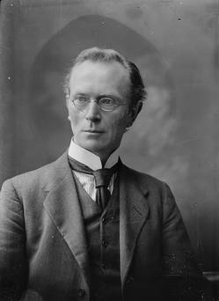
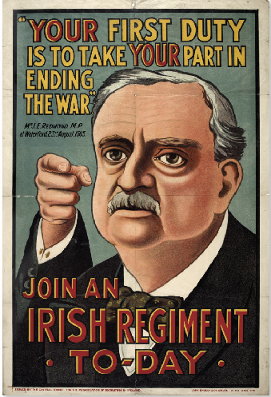
Chief of Staff of the Irish Volunteers Eoin MacNeill (left) confronted Pearse before the
Rising while Irish Parliamentary Party leader John Redmond had pledged support for
the British war effort.
Athboy 100

Slide 17
Run-up to the Rising (contd.)
April 22nd (Easter Saturday) - Eoin MacNeill cancels the order for the Rising.
April 23rd (Easter Sunday) - IRB decides to put Rising on hold for 24 hours.
April 24th (Easter Monday) - The 1916 Rising begins in Dublin.
Athboy 100

Slide 18
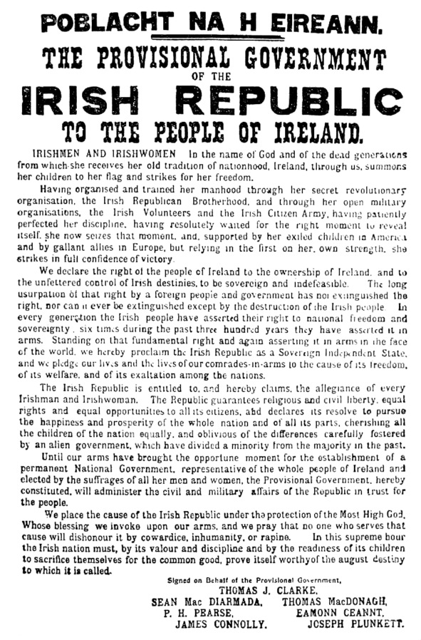
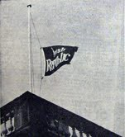
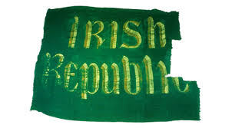
Day 1: Monday
Athboy 100

Slide 19
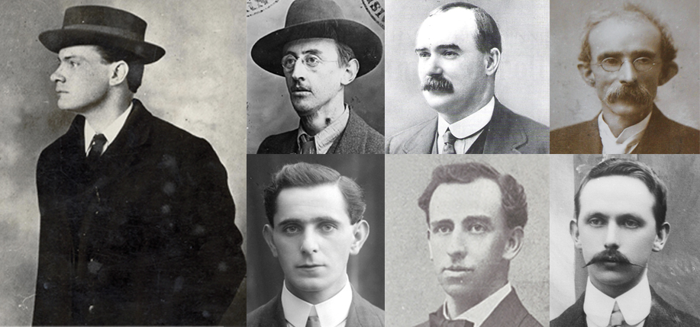
Signatories of the Proclamation, clockwise from left-
Pádraig Pearse, Joseph Plunkett, James Connolly, Thomas Clarke,
Eamonn Ceannt, Thomas MacDonagh, Seán MacDiarmada
Athboy 100

Slide 20
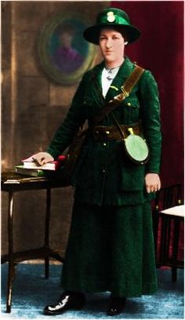
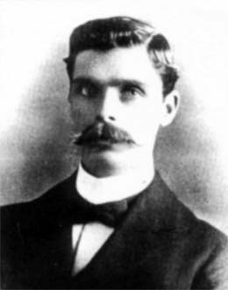
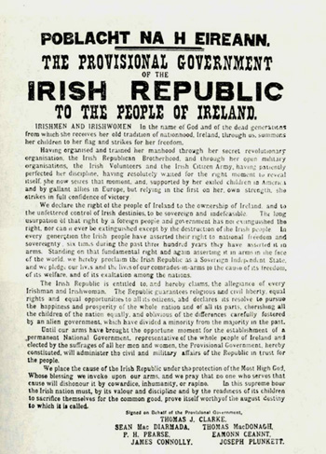
Day 2: Tuesday
(Left) Helena Moloney, (above) Michael Mallin
Athboy 100

Slide 21
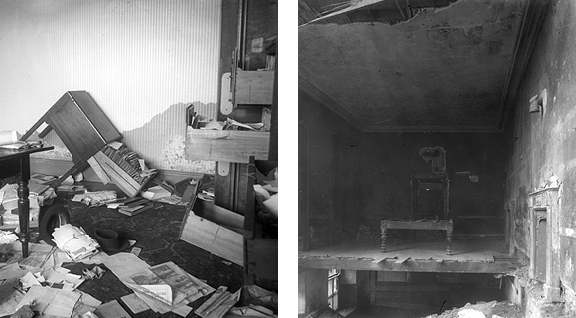
Day 3: Wednesday
Scenes of destruction inside Liberty Hall after it was riddled by British artillery
Athboy 100

Slide 22
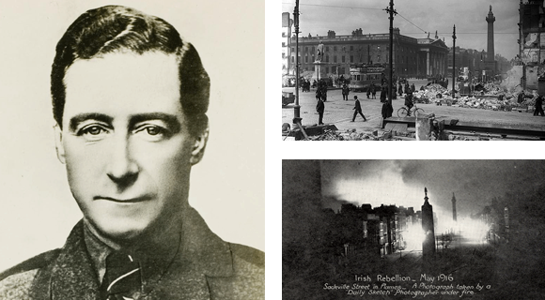
Day 4: Thursday
Left: Cathal Brugha was wounded more than 25 times in the fighting.
Right: Scenes of destruction after heavy nights of shelling around Sackville Street.
Athboy 100

Slide 23
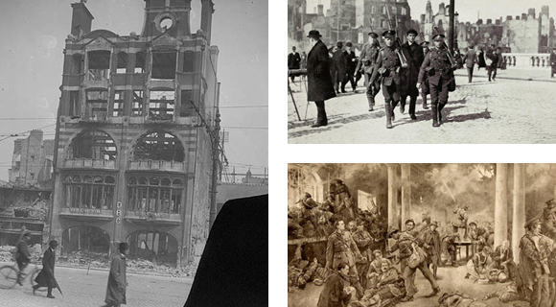
Day 5: Friday
The Dublin Bread Company building on Sackville Street didn't survive the
tumultuous events of Easter week. Right, a rebel is taken prisoner and, below,
an artist’s impression of the Volunteers holding out in the GPO.
Athboy 100

Slide 24
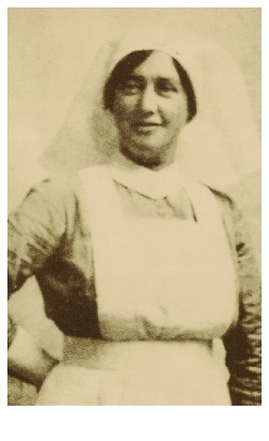
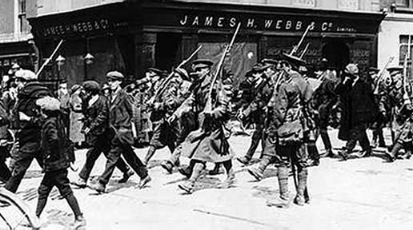
Day 6: Saturday - Surrender
Right: Elizabeth O’Farrell. Left: Volunteers marched from the GPO by British troops.
Athboy 100

Slide 25
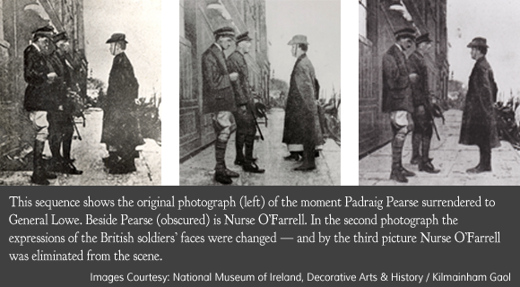
Athboy 100

Slide 26
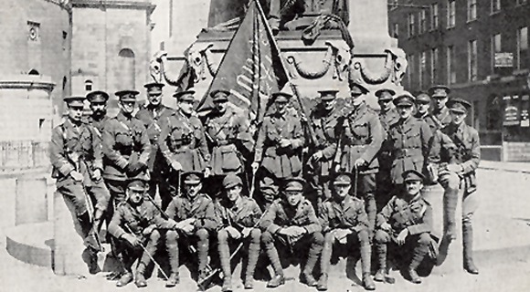
Aftermath of the Rising
British soldiers pose with the captured rebel flag on Sackville Street
Athboy 100

Slide 27
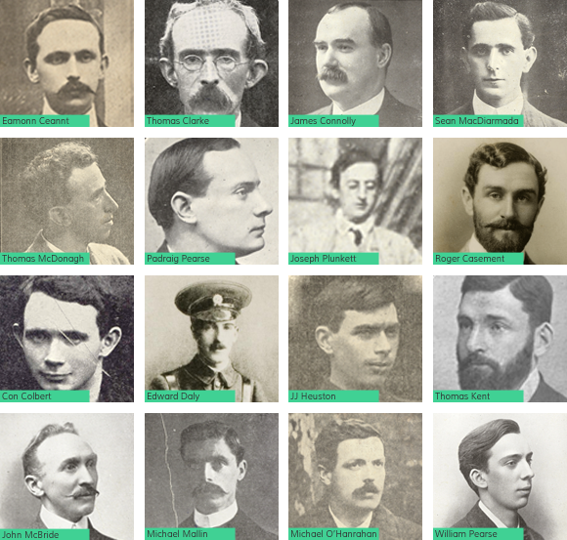
Athb

Slide 28
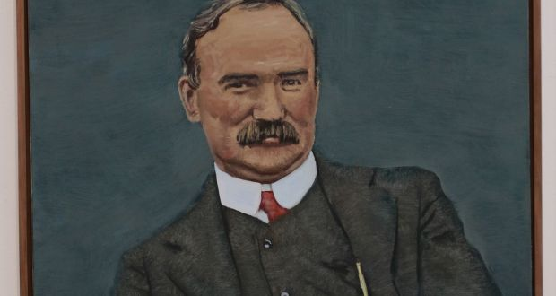
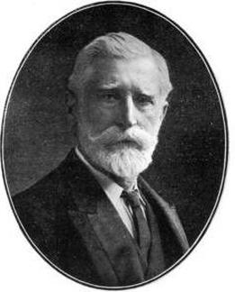
“If these men are treated with too great leniency,
they will take it as an indication of weakness on
the part of government and the consequences may
not be satisfactory. They may be more truculent than ever,
and it is therefore necessary that society should be protected
against their activity.”
William Martin Murphy, owner of the Irish Independent
Athboy 100

Slide 29
16 Leaders Executed
May 3rd: Pádraig Pearse, Tom Clarke, Thomas MacDonagh
May 4th: Joseph Plunkett, Ned Daly, Michael O’Hanrahan, Willie Pearse
May 5th: John MacBride
May 8th: Eamonn Ceannt, Michael Mallin, Seán Heuston, Con Colbert
May 9th: Thomas Kent
May 12th: Seán MacDiarmada, James Connolly
August 3rd: Roger Casement (at Pentonville Prison, London)
Athboy 100

Slide 30
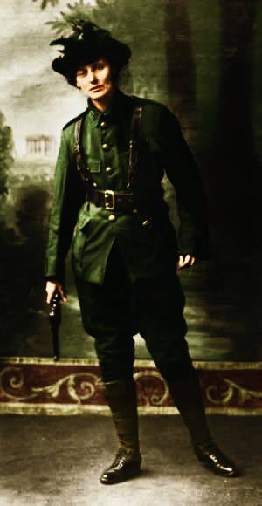
Constance Markievicz
Athboy 100

Slide 31
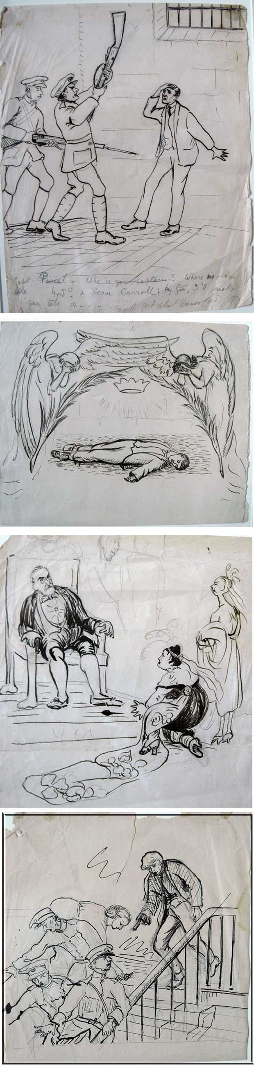
In Kilmainham
Gray dawn and Spring
I cannot sleep
Despair is in my brain
The dead hours throu the prison creeps
As if they felt the pain
As if the pain would stop and weep
And times grim hand restrain
Drawings and poem by Constance Markievicz from her cell
in Kilmainham Jail
Athboy 100

Slide 32
A dream realised…?
‘The Irish Republic is entitled to, and hereby claims, the allegiance of every Irishman and Irishwoman. The Republic guarantees religious and civil liberty, equal rights and equal opportunities to all its citizens, and declares its resolve to pursue the happiness and prosperity of the whole nation and of all its parts, cherishing all of the children of the nation equally, and oblivious of the differences carefully fostered by an alien Government, which have divided a minority from the majority in the past.’

Slide 33
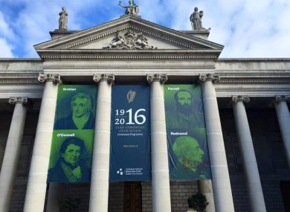
In 2016, a controversial banner hangs over the Central Bank
Athboy 100

Slide 34



Go raibh maith agaibh
athboy100.com
facebook.com/athboy100
@athboy100
YouTube.com/Athboy100

Slide 35
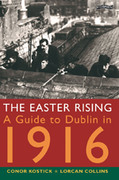
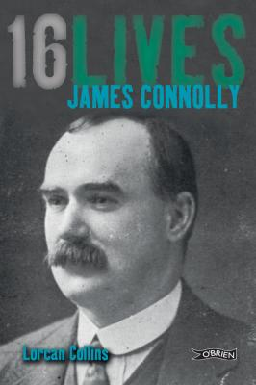
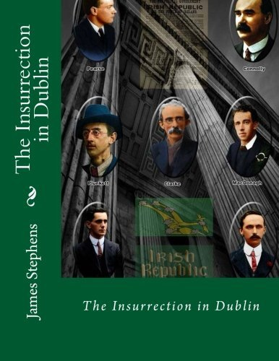
Sources
1916 Walking Tour (www.1916rising.com)
The Easter Rising: A Guide to Dublin
16 Lives series (www.16lives.com)
James Stephens’ diary of Easter week, The Insurrection In Dublin
Athboy 100

